Slide 1
Virtual Fencing System experiment: Testing the response of sheep on various audio signals
Author: Natasa Kleanthous
Director of Studies: Prof. Abir Hussain
Supervisors: Dr. Jenny Sneddon, Prof. Andy Shaw
External Advisor: Dr. Alex Mason
Department: Computer Science

Slide 2
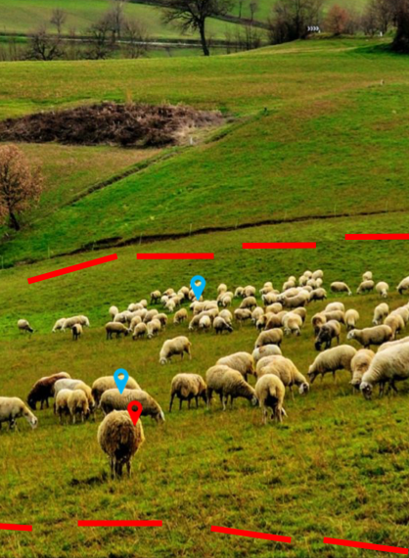
What?
Create a virtual fencing system
Remove physical barriers and replace them with “virtual” barriers
Why?
Improve biodiversity
Prevent overgrazing
Reduce soil erosion and water pollution

Slide 3
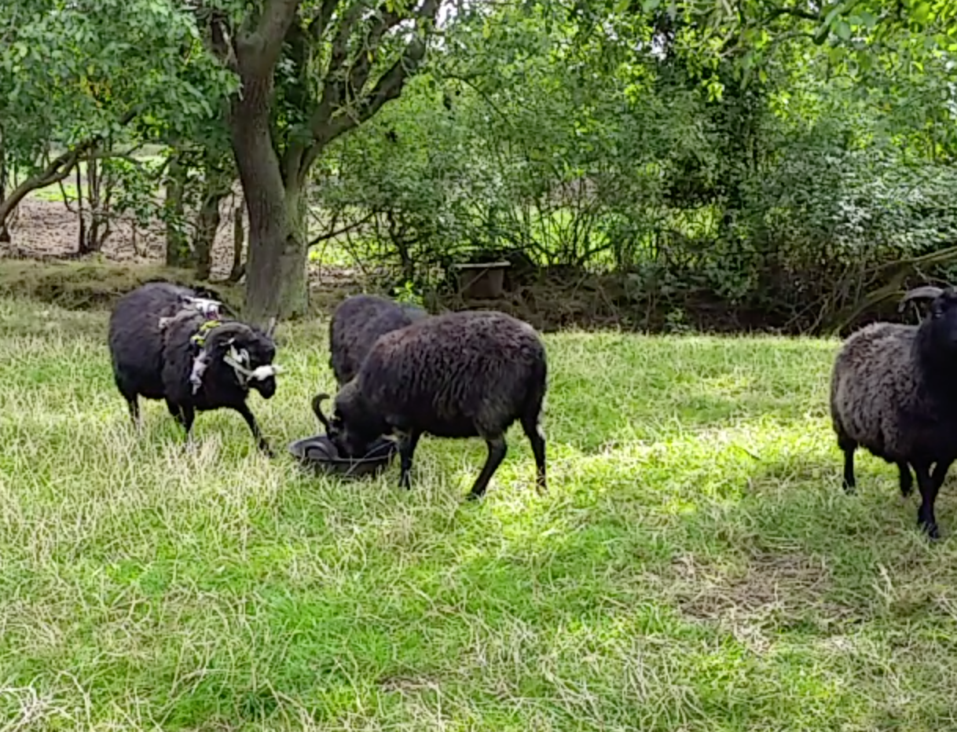
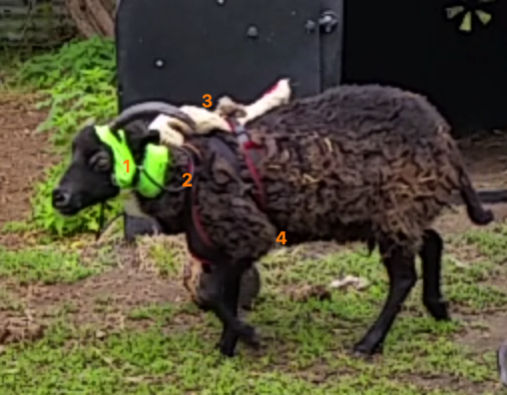
How?
examine the response of the animals on the acoustic cues: which sounds restrict them access to an attractant?
Five Hebridean sheep were used in the pilot experiment
Frequencies between 200 Hz – 17000 Hz
A sound cue was emitted manually from the laptop to the speakers when the animal was approaching the attractant
Bluetooth stereo speakers, (b) dismantled speakers enclosed in an ABS box, (c) ABS box to be mounted on a halter

Slide 4
Preliminary results and conclusion
High frequencies can cause the desired reaction (ex. 17000 Hz with 86.67% success)
White noise was 95% successful however it caused stress to the animals
The animals’ temperament is important: timid animals are easier to be trained in comparison to stronger animals in character
Next experiment will use a larger cohort of animals with focus on frequencies higher or equal to 17000 Hz
White noise will be emitted only when necessary

